Slide 1
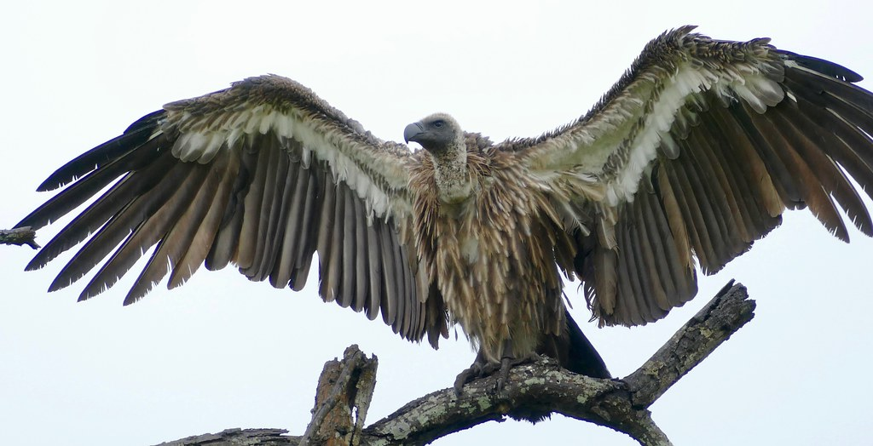
WHITE RUMPED VULTURE Gyps bengalensis PRESENTED BY TIYASHA BISWAS CU ROLL N0:223144-11-0040 CU REGISTRATION NO:144-1214-0283-22
This Photo by Unknown Author is licensed under CC BY-SA

Slide 2
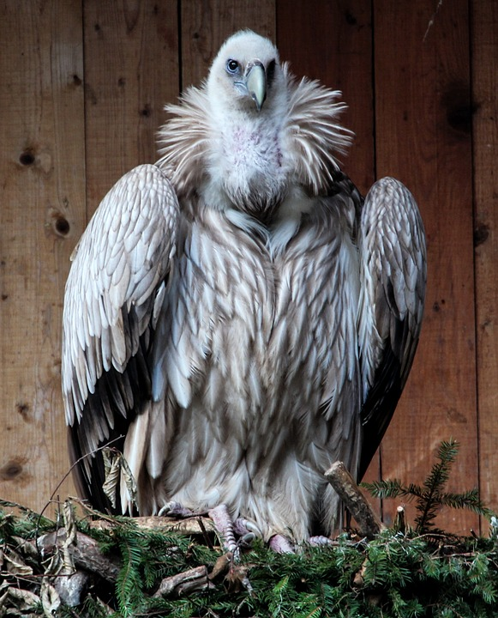
SYSTEMATIC POSITION
According to “The life of vertebrate” by J.Z YOUNG ,1981
Domain: Eukaryota
Kingdom: Animalia
Phylum: Chordata
Class: Aves
Order: Accipitriformes
Family: Accipitridae
Genus: Gyps
Species: G. bengalensis

Slide 3
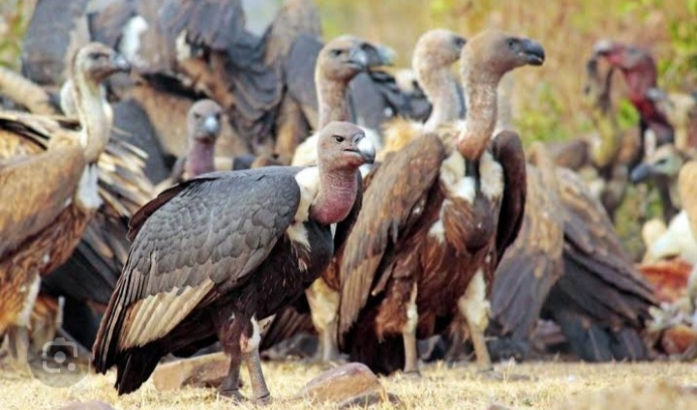
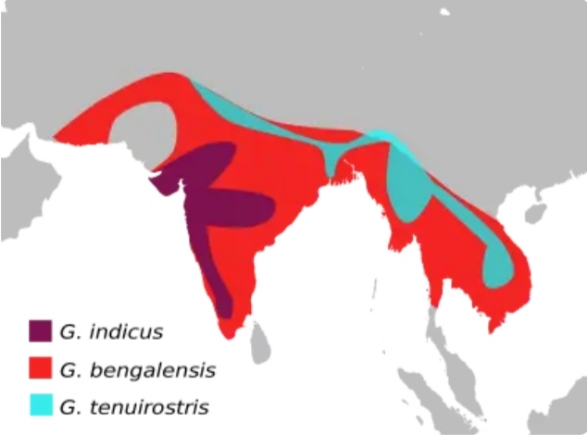
MORPHOLOGICAL CHARACTERISTIS
MEDIUM SIZED,DARK VULTURE AND BULKY SCAVENGER.
Unfeathered dark brown head.
broad wings , and short tail feather.
It also has a white ruff around its neck.
ADULTS ARE 75 TO 85 cm tall.
Wing span is 180 to 210 cm.
Weight ranges from 3.5 to 7.5 kg.
Lifespan:40 to 45 year.
Geographical distribution:
India , Pakistan , Bangladesh ,
Nepal , Bhutan , Myanmar,
Thailand , Loas ,and Southern Vietnam.

Slide 4
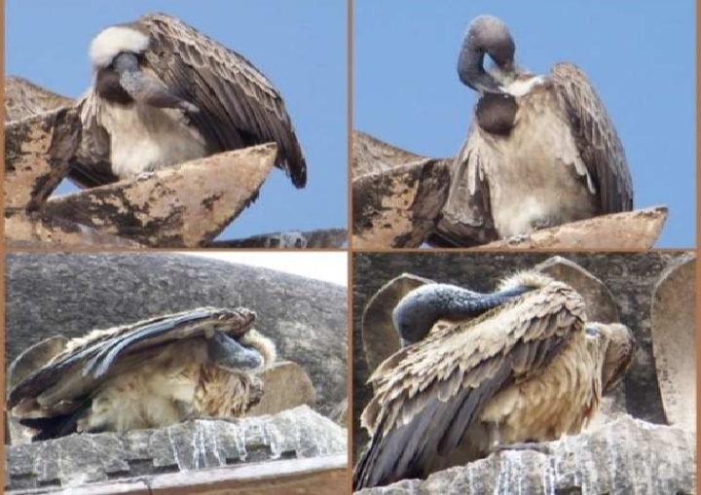
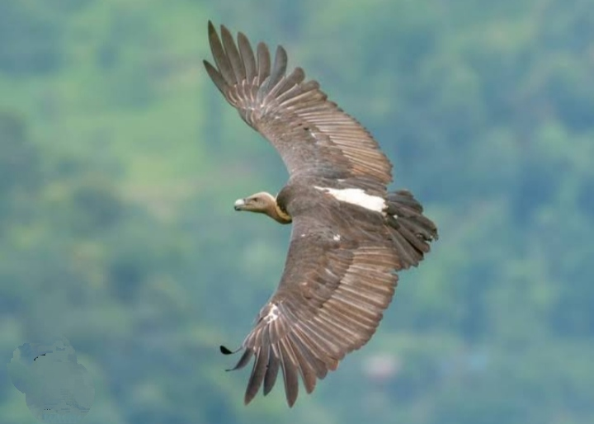
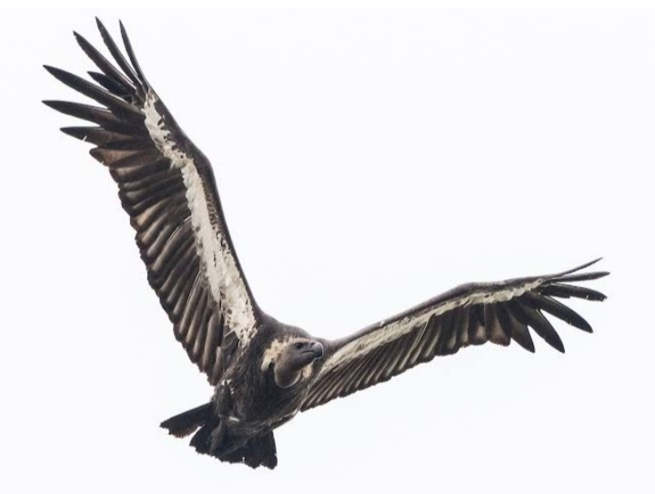
GENERAL BEHAVIOUR
Unique bird characteristics where the bird squeeze the sebaceous secretion from the uropygial gland and transfer it across the entire body with the help of its beak.
Preening helps in maintaining correct alignment of feathers with all interlocking barbules in place. It also helps in keeping feathers waterproof, clean plumage and keep ectoparasites in check.
White-rumped vultures usually become active when the morning sun is warming up the air so that thermals are sufficient to support their soaring.
LIFESTYLE: Arboreal, Terrestrial, Congregatory.

Slide 5
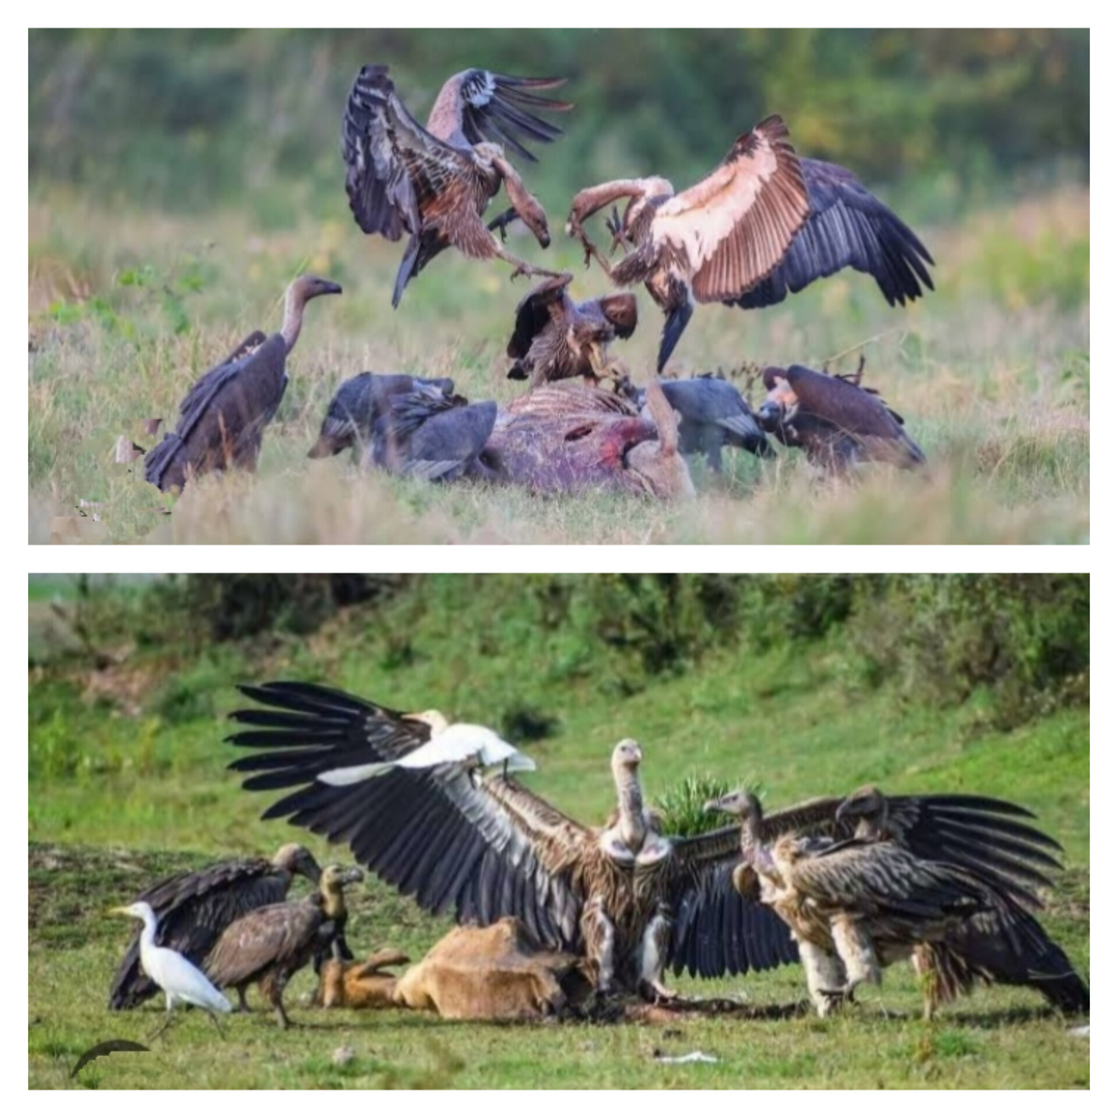
FEEDING BEHAVIOUR
Mammals serve as the predominant source of carrion, but dead birds, reptiles, amphibians, and invertebrates also are consumed. Vultures prefer to eat “freshly” dead carrion, but they also will feed on decaying carcasses.
Most vultures have broad food habits, consuming carrion, garbage, and even excrement, but rarely do they descend upon live animals.
Like other vultures it is a scavenger, feeding mostly on carcasses, which it finds by soaring high in thermals and spotting other scavengers.

Slide 6
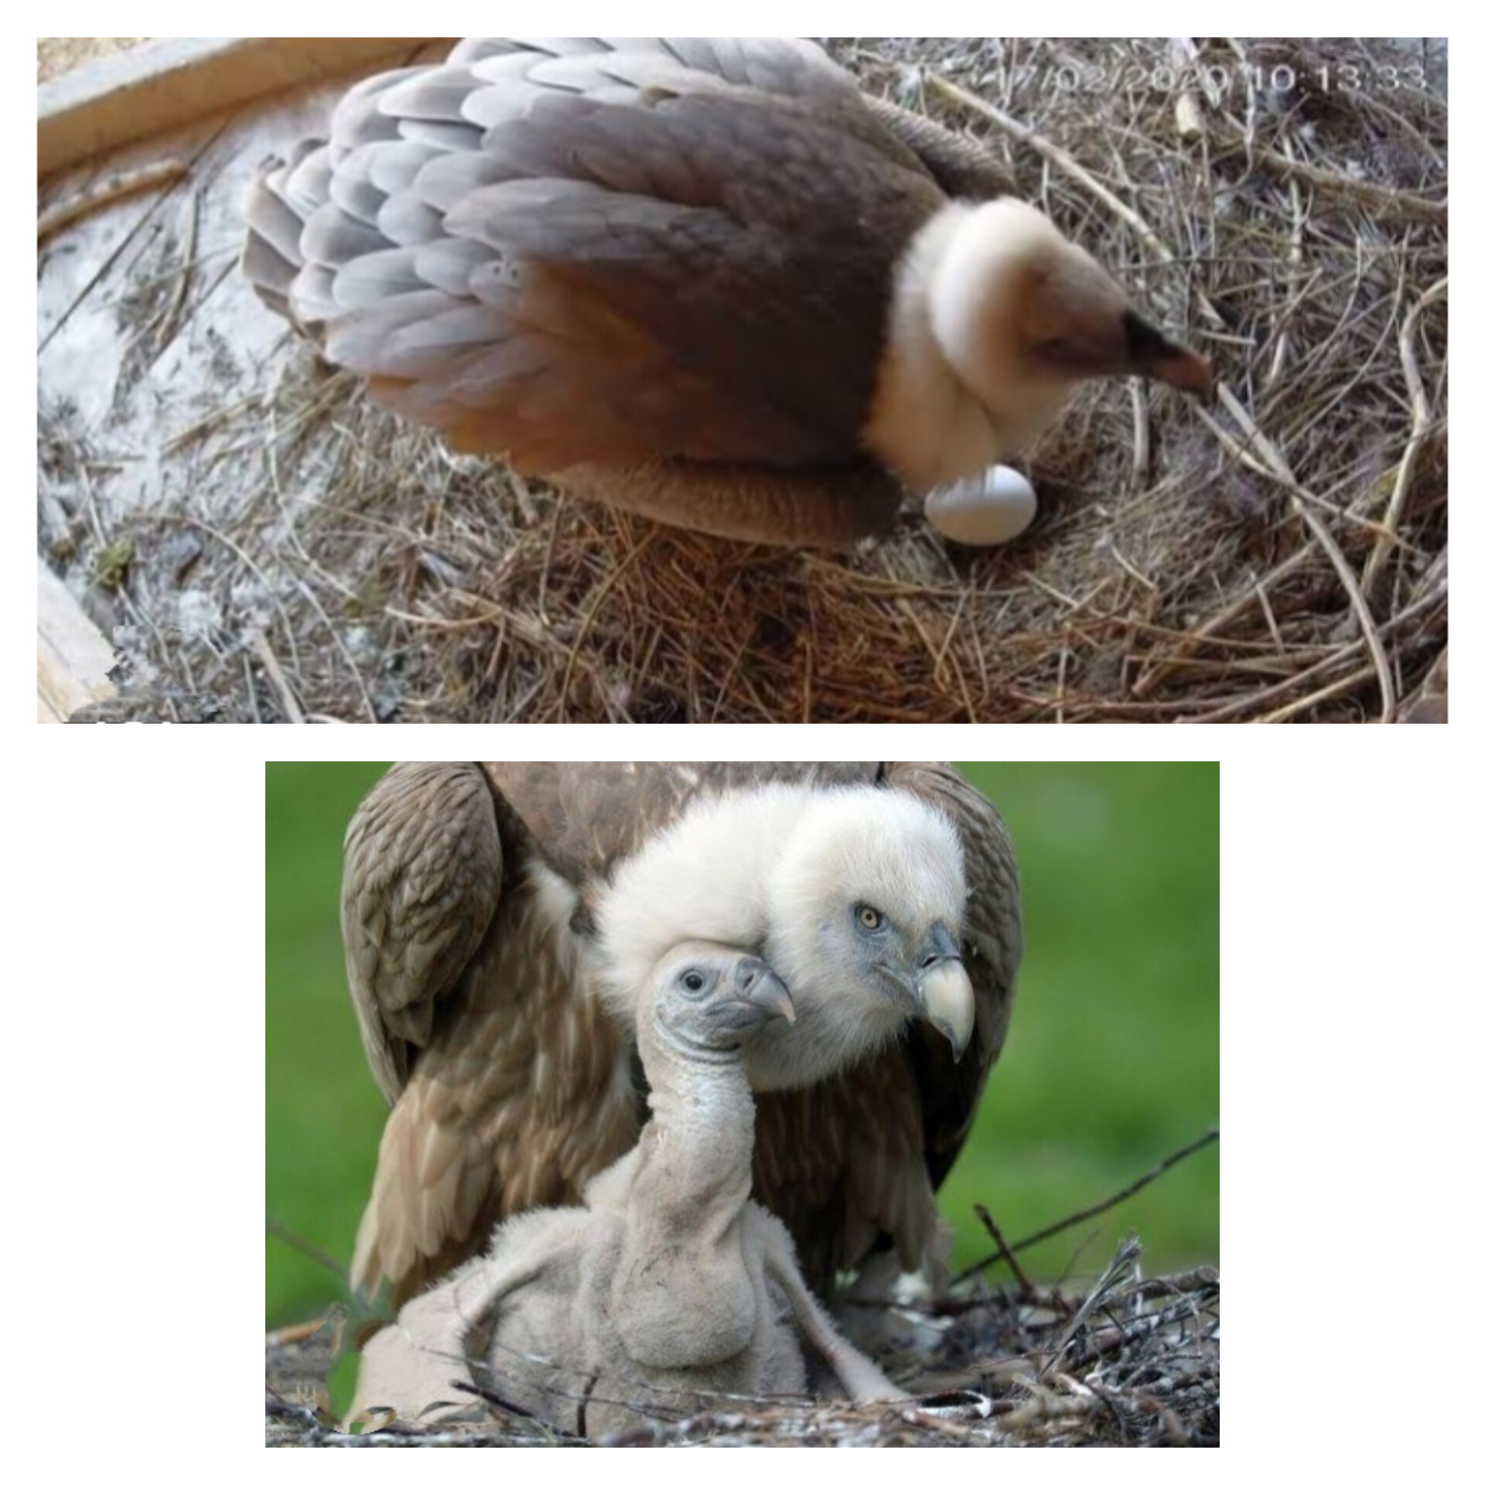
BREEDING BEHAVIOUR
They are oviparous, meanings they lay egg to reproduce.
The white-rumped vultures breed during October to March. They usually breed in colonies in tall trees.
They nest is built with sticks and lined with leaves.
Usually a single egg is laid , which is white with a tinge of bluish green.
The egg hatch after about 30 to 35 days of incubation.

Slide 7
Acknowledgement
In the accomplishment of completion of my project on The White Rumped Vulture.I would like to convey my special gratitude to our department of zoology Of Bangabasi Morning College Your valuable guidance and suggestions helped me in various phases of the completion of this project. I will always be thankful to you in this regard.I am ensuring that this project was finished by me .
THANK YOU
-----------------------------------------------------------------------------------------------------------------------------------------------------------------------------------------------------------------------------------------------------------------------------------------------------

